Slide 1

Week 1 – Clarification
Objectives:
- Students receive a clear overview of the aims and expectations of the task, with explicit reference to the knowledge and skills developed, expected outcomes and timeline.
- Students study Transactional Writing/Speaking: Teaching/Reminding students how to analyse and craft a persuasive speech using a wide range of Rhetorical Devices
Approx 2-3 lessons

Slide 2


‘Mark My Words’
Y8 Oracy Competition
25 September 2026

Slide 3


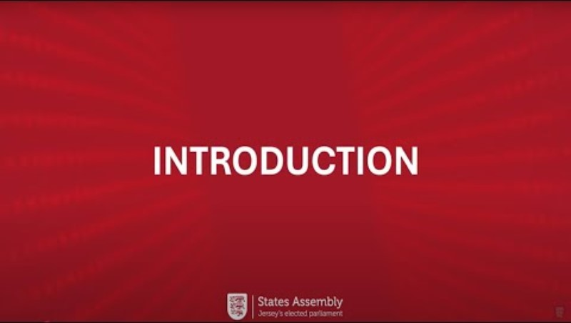
WELCOME
From the States Assembly Education Team
Notes:
INTRODUCTION: Mark My Words

Slide 4


‘Mark My Words’ Year 8 Oracy Competition
In association with
The Jersey Oracy Network
Your Challenge: Presenting a 3 minute persuasive speech
Crafting, Communicating and Critiquing
a proposal for change in our Island

Slide 5

‘Mark My Words’ – Year 8 Oracy Competition
WHAT WILL YOU BE LEARNING ABOUT?
Persuasive Writing
Public Speaking
Critical Thinking
Delivering proposals in a political context
Notes:
Persuasive Writing: How to craft a clearly structured and engaging proposal for change
Public Speaking: How to communicate your proposal effectively to convey meaning, mood and message
Critical Thinking: How to critique proposals by posing probing questions and responding to questions directly, clearly and fully
Delivering proposals in a political context: How to write and deliver speeches for local change within our Island, with finalists speaking and responding to questions in the States Chamber in front of politicians

Slide 6

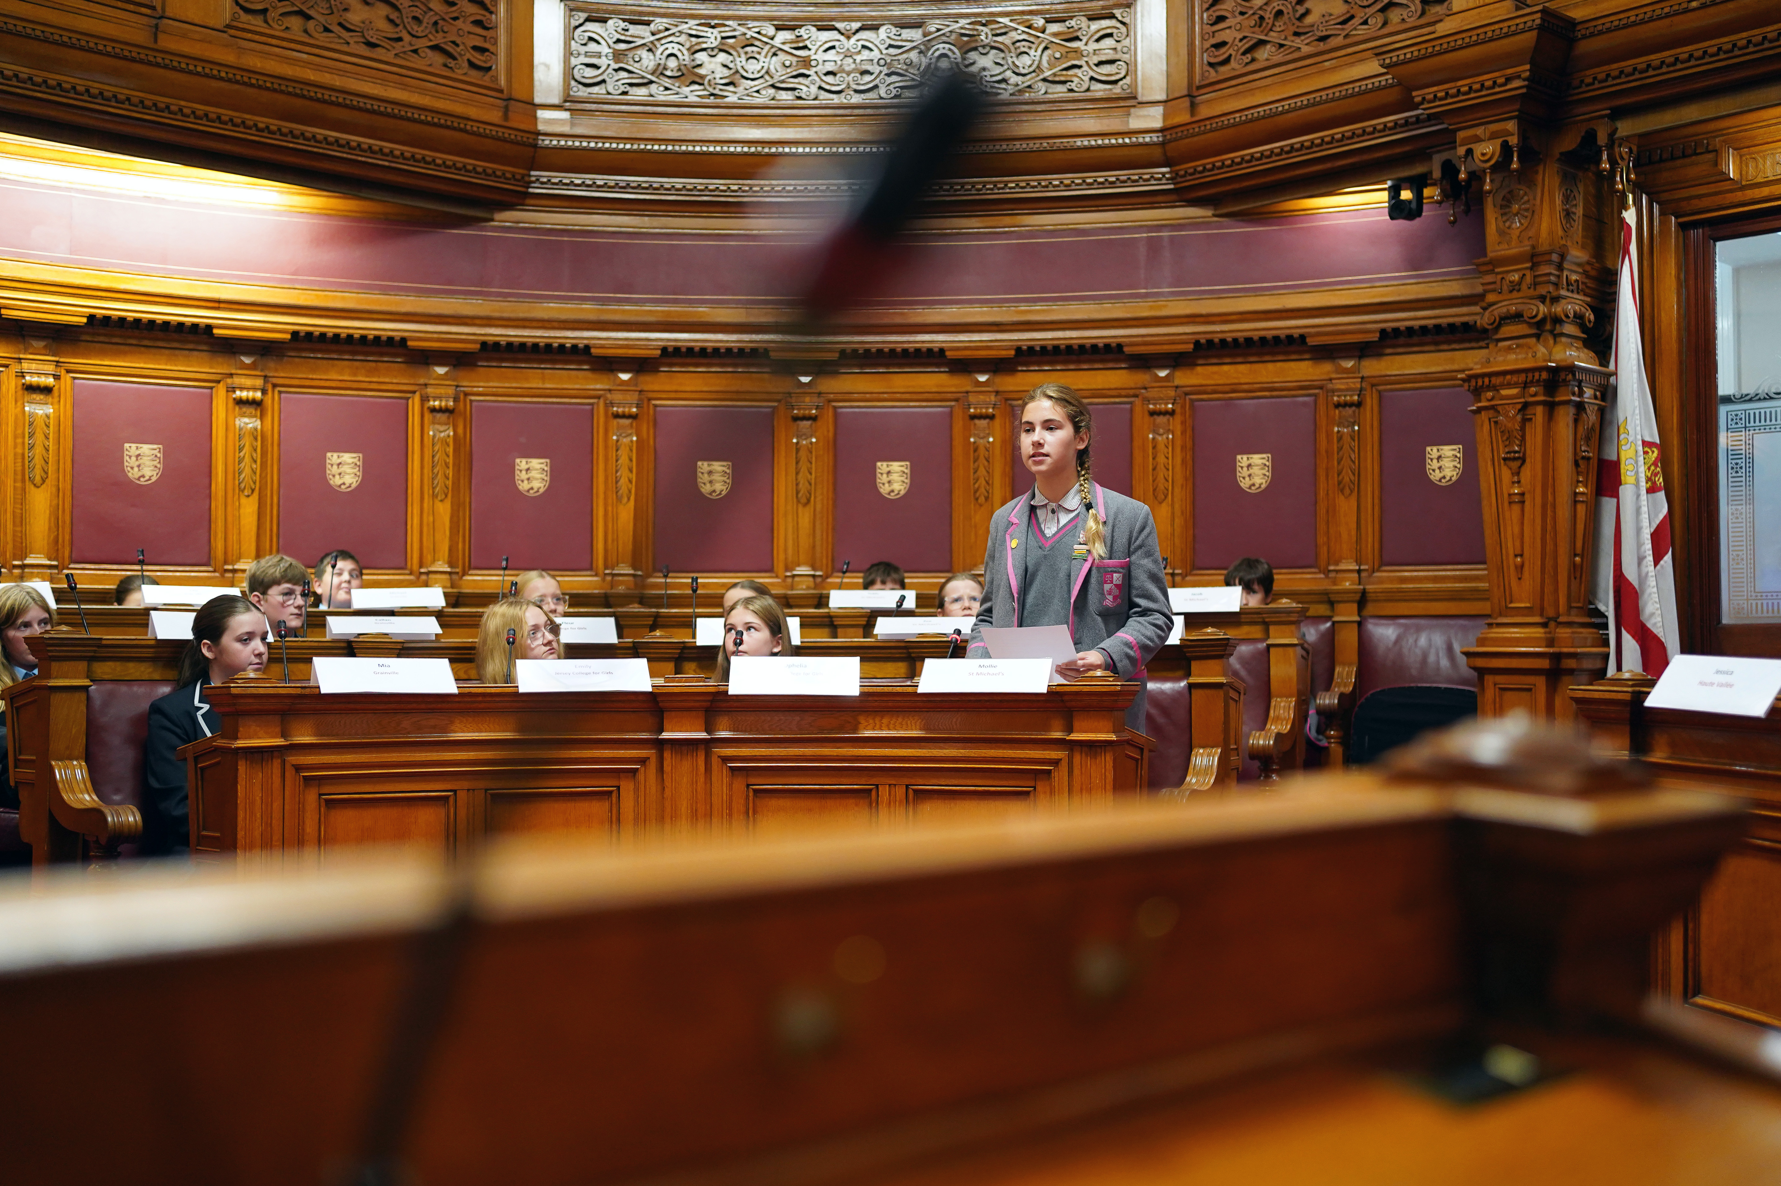

‘Mark My Words’ Year 8 Oracy Competition
WHAT WILL YOU BE DOING?
Developing skills of crafting, communicating and critical thinking.
Identifying a local change you wish to see, within a topic of interest.
Writing a 3 minute speech , persuading others of the need for this change.
Practising your speech and answering questions.
Competing at class and year group level.
Sending your finalist and up to 5 other students to the States Chamber for the Inter-Schools competition during Democracy Week on Friday 25th September.
There is a trophy for the student who is the overall winner and £500 for their school.

Slide 7



Pair/Group/Class Discussion
What is a speech?
Who makes speeches and why?
How have speeches changed the world?
How is a speech different to a piece of writing?
Why is this skill important?

Slide 8

AN EXEMPLAR SPEECH:
Why Oracy should be compulsory in Schools
Let’s consider the importance of Oracy a little more with our EXEMPLAR SPEECH
which demonstrates WHY we are doing this competition and WHAT is expected.
Notes:
EXEMPLAR SPEECH: Mark My Words - YouTube

Slide 9



Pair/Group/Class Discussion
CRAFTING A SPEECH: LIST AS MANY RHETORICAL DEVICES AS YOU CAN
What TACTICS can be used to make a
piece of writing or a speech more persuasive?
THINK about the “Speak Up, Speak Out” competition in Year 6
Notes:
What do you remember from your Year 6 experience
of the ‘Speak Up, Speak Out’ competition, or any past
experience of either public speaking or persuasive writing?

Slide 10

CRAFTING A SPEECH: How many of these
Rhetorical Devices did you think of?
The Hook
Alliteration
Triadic Structure
Repetition or Refrain
Emotive Language
Evidence/Facts/Statistics
Rhetorical Questions
Examples/Analogies/Anecdotes
Metaphors/Similes/Imagery
Rhymes/Slogans/Quotes
Comparisons
Direct Address to Audience ‘You’
Exaggeration and Hyperbole
A ‘Call to Action’
Summary

Slide 11


What Rhetorical Devices will make my writing exciting?
A powerful and engaging start
to your speech that grabs the
audience’s attention!
Could be:
a shocking fact or statistic
an anecdote or joke
repetition or rhyme
a direct address to the
audience with a ‘What if…? question or ‘Imagine….’
The Hook
Notes:
A powerful and engaging start
to your speech that grabs the
audience’s attention from the
beginning.
The hook can be many things –
a shocking fact or statistic, an
anecdote or joke, repetition or
rhyme, a direct address to the
audience with a ‘What if…?
question or ‘Imagine….’

Slide 12
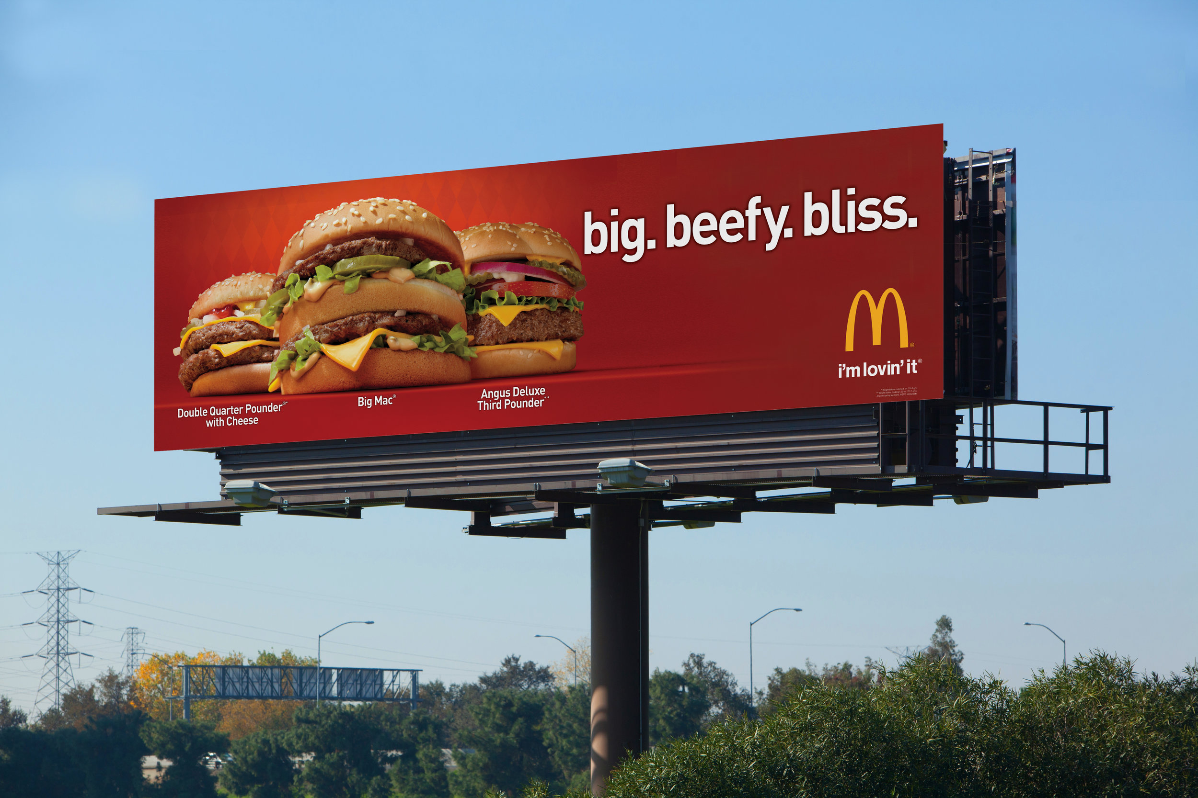
What Rhetorical Devices will make my writing exciting?
Alliteration
Using words one after the other, or in quick succession, that start with the same letter
E.g. ‘We want our Island to be
strong, stable and successful’
OR that start with the same sound
E.g. ‘He is a quick, capable Kayaker’

Slide 13

What Rhetorical Devices will make my writing exciting?
Triadic Structure
Also known as ‘The Rule of Three’.
This is when there are three main
words or clauses in a sentence or phrase.
E.g. “I came; I saw; I conquered”
from Julius Caesar.
In Latin - “Veni; vidi; vici”
OR
“It’s unnecessary, unhelpful
and unacceptable.”
Notes:
Also known as ‘The Rule of Three’.
This is when there are three main
words or clauses in a sentence or phrase.
E.g. “I came; I saw; I conquered”
from Julius Caesar.
In Latin - “Veni; vidi; vici”
OR
“It’s unnecessary, unhelpful
and unacceptable.”

Slide 14
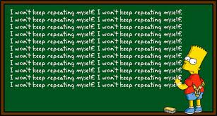
What Rhetorical Devices will make my writing exciting?
Repetition/Refrain
Repetition involves using the same words several times for emphasis.
E.g. ‘Poverty is unacceptable, hunger is
unacceptable, ignoring both is unacceptable!’
A Refrain is a repeated phrase
that makes the speech more poetic
E.g. Martin Luther King’s “I have a Dream”
Notes:
Repetition involves using the same words, or group of words, several times for emphasis.
E.g. ‘Poverty is unacceptable, hunger is
unacceptable, ignoring both is unacceptable!’
A Refrain is a repeated phrase, verse,
slogan or quote that makes the
speech more poetic or even musical to the ear.
E.g. Martin Luther King’s “I have a Dream”

Slide 15
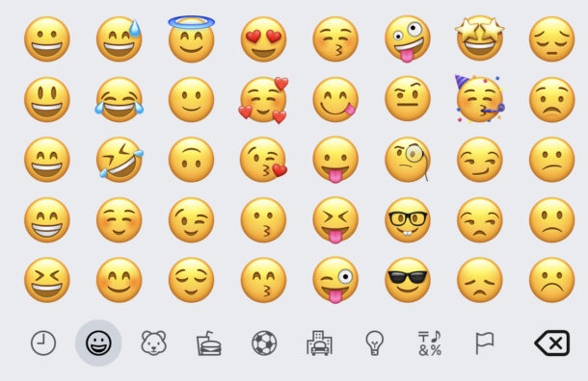
What Rhetorical Devices will make my writing exciting?
Emotive Language
Strong, powerful words and phrases
prompt an emotional response in the audience
E.g. devastating, horrifying, outrageous
Emotive Language changes the impact
E.g. ‘This is not the case for all children’ could become
‘Tragically, this is not the case for all children’
Notes:
Strong, powerful words and phrases
that are chosen to prompt an
emotional response in the audience –
E.g. devastating, horrifying, outrageous
Emotive Language changes the mood
and impact of a sentence.
E.g. ‘This is not the case for all children’
could become
‘Tragically, this is not the case for all
children’

Slide 16

What Rhetorical Devices will make my writing exciting?
A speech becomes more persuasive and
convincing if views and ideas are backed up
with evidence .
Undertaking research to offer some key
facts to support your claims will strengthen
your argument.
Statistics are a particularly
useful form of evidence, for example,
“1% of the world owns 99% of the wealth”
Evidence/Facts
Statistics
Notes:
A speech becomes more persuasive and
convincing if views and ideas are backed up
with evidence – proof of the problem and
proof that there is a solution.
“Evidence shows that….”
Undertaking research to offer some key
facts to support your claims will strengthen
your argument. Statistics are a particularly
useful form of evidence as they are a quick,
clear, formal way of highlighting trends.
“1% of the world owns 99% of the wealth”

Slide 17

What Rhetorical Devices will make my writing exciting?
Rhetorical
Questions
Questions that are asked for effect or to make a point, or to show the speaker’s view.
“Should we put up with this?”
“Are we ready for this?”
“Why does this matter?”
“Are they serious?”
Notes:
A Rhetorical Question does not expect or require an answer.
It is a question that is asked for effect or to make a point, or to show the speaker’s view.
“Should we put up with this?”
“Are we ready for this?”
“Why does this matter?”
“Are they serious?”

Slide 18

What Rhetorical Devices will make my writing exciting?
Examples, Anecdotes
and Analogies
Examples
“Let’s do our bit for the environment, for
example by recycling our waste”
Anecdotes
“The need to take more risks reminds me of the time I tried the Tower of Terror at Disney World”
Analogies
“Oracy is to speaking, what Literacy is to reading”
Notes:
Examples are used to illustrate a general
point more specifically:
“Let’s do our bit for the environment, for
example by recycling our waste”
Anecdotes are a short story that develop
ideas and make them real and relatable:
“The need to take more risks reminds me of the
time I tried the Tower of Terror at Disney World”
Analogies make a comparison with something
familiar to explain or clarify more clearly.
“Oracy is to speaking, what Literacy is to reading”

Slide 19

What Rhetorical Devices will make my writing exciting?
Imagery/Metaphors Similes
Imagery: vivid descriptive language that paints a
Picture
“She lights up a room”
Metaphors: A figure of speech that describes one thing
as another.
“They were peas in a pod”
Similes: A figure of speech that describes something
as similar to something else using ‘like’ or ‘as’.
“It hit me like a ton of bricks”
Notes:
Imagery: vivid descriptive language that paints a
picture and appeals to the human senses to create a
physical response in the audience.
“She lights up a room”
Metaphors: A figure of speech that describes one thing
as another to give a clearer sense of what it is like.
“They were peas in a pod”
“Life is a rollercoaster”
Similes: A figure of speech that describes something
as similar to something else using ‘like’ or ‘as’.
“It hit me like a ton of bricks”
“She must be as blind as a bat”

Slide 20

What Rhetorical Devices will make my writing exciting?
Rhymes/Slogans/ Quotes
Rhyme:
“The juicing sensation that’s sweeping the nation!”
Slogan:
“Just do it” (Nike)
Quote:
“Be the change you wish to see in the world” (Gandhi)
Notes:
Rhyme: A repetition of similar sounds
“The juicing sensation that’s sweeping the nation!”
Slogan: A short, catchy phrase that is easy to
remember.
‘Believe in Better’ (Sky) “Just do it” (Nike)
Quote: Repeating the exact words written or spoken
by another person.
“Be the change you wish to see in the world” (Gandhi)
“Genius is one percent inspiration and ninety percent
perspiration” (Thomas Edison)

Slide 21

What Rhetorical Devices will make my writing exciting?
Comparisons
Showing the similarities or differences
Between two or more things.
“Jersey is at the bottom of the league table for
voter turnout. Whilst 80% of Guernsey voters
and 60% of UK voters participated in their most
recent elections, in Jersey it was only 42%”

Slide 22

What Rhetorical Devices will make my writing exciting?
Direct Address to
Audience – “You”
Speaking directly to your audience to
create a sense of intimacy and draw the
audience in deeper.
“They say you can’t do it,
but I say you can!”

Slide 23

What Rhetorical Devices will make my writing exciting?
Exaggeration and
Hyperbole
Exaggeration:
“Everyone now faces poverty”
Hyperbole:
“I’m giving this two hundred per cent!”
Notes:
Exaggeration: Representing something
as better or worse than it really is.
“Everyone now faces poverty”
Hyperbole: Extravagant exaggeration
for a particular purpose. It is not meant
to be taken literally, but is designed to
emphasise a point or add humour.
“I’m giving this two hundred per cent!”

Slide 24

What Rhetorical Devices will make my writing exciting?
A ‘Call to Action’
Often coming at the end of a speech,
a ‘call to action’ encourages the
audience to think or do something.
“Let’s all use our voices to speak out on
bullying and speak up for victims”
Notes:
Often coming at the end of a speech,
a ‘call to action’ encourages the
audience to think or do something. It
delivers a strong, punchy ending
designed to inspire and motivate those
listening.
“Let’s all use our voices to speak out on
bullying and speak up for victims”

Slide 25

What Rhetorical Devices will make my writing exciting?
Summary
A short, clear outline of the main
points or ideas.
“ Therefore, it is clear that, firstly, we
need to recognise the problem,
secondly, we have to agree on a solution
and, finally, we must put that solution
into action, and fast!”

Slide 26

CRAFTING A SPEECH:
Let’s play Rhetorical Device Bingo!
TASK 1: Listen again to the exemplar speech on ‘Why Oracy should be compulsory’ and see how many Rhetorical Devices you can spot. Tick them off on your Bingo card as you hear them.
THE HOOK | ALLITERATION | TRIADIC STRUCTURE | REPETITION/REFRAIN
EVIDENCE/FACTS STATISTICS | RHETORICAL QUESTIONS | EXAMPLES/ANECDOTESANALOGIES | METAPHORS/SIMILES IMAGERY
COMPARISONS | DIRECT ADDRESS TO AUDIENCE – “YOU” | EXAGGERATION AND HYPERBOLE | A ‘CALL TO ACTION’

Slide 27
CRAFTING: What Rhetorical devices are being used in this speech?
TASK 1: Listen again to the EXEMPLAR SPEECH. Tick off any Rhetorical devices you hear.
Notes:
EXEMPLAR SPEECH: Mark My Words - YouTube

Slide 28
CRAFTING: How do I structure a strong speech?
The Hook
The Diagnosis
The Vision
The Plan
The Conclusion
Grab your audience’s attention with an interesting start
Explain the problem, its causes and its impact
Present what your idea is for change, what you wish to see
Outline how this change will happen, what needs to be done
Deliver your final and main message in a memorable way

Slide 29
CRAFTING: Can you spot the structures in a speech?
TASK 2: CONSOLIDATE YOUR KNOWLEDGE:
You will receive a transcript of the exemplar speech.
Annotate the Rhetorical Devices you find in the text using these CODES:
CIRCLE any examples of Repetition/Refrain and UNDERLINE any Rhymes
Identify the structure of this speech by using 5 different COLOURS in the margins to show:
1) The Hook 2) The Diagnosis 3) The Vision 4) The Plan 5) The Conclusion
Alliteration: A | Statistics: S | Quote: Q
Direct Address: U | Rhetorical Qu: ? | Triadic Structure: 3

Slide 30
Week 1/2 – Crafting
Objective:
Students use Rhetorical Devices and Writing Frame to craft their own persuasive speech that identifies a current local problem and argues for change.
Approx 2-3 lessons

Slide 31






OVER TO YOU: Time to pick your topic!
You can pick a topic or issue that fits within any of the following three broad themes: Conflict Sustainability Social Responsibility REMEMBER – Your speech must be a proposal for LOCAL CHANGE, so do relate any topic or issue to an improvement you wish to see in JERSEY.
Notes:
Your teacher may direct you to think of topics and issues within just one of these themes depending on what you have been studying recently.

Slide 32
CONFLICT
What could I write a speech about?
THINK ABOUT IMPORTANT CURRENT ISSUES
Should Jersey spend more money on overseas aid to help war-torn countries?
Should Jersey introduce National Service for 16 – 25 year olds to prepare for the possibility of war?
Should Jersey ban social media or smart phones for under 16s to prevent online harm?
Should there be stronger penalties for youth crime to act as a deterrent?
Should the Channel Islands, especially Jersey and Guernsey, work more closely together to share ideas and save money?
Should Jersey follow the UK and make assaults on members of the emergency services a specific offence with tougher penalties?

Slide 33
SUSTAINABILITY
What could I write a speech about?
THINK ABOUT IMPORTANT CURRENT ISSUES
Should Jersey offer more financial incentives such as loans or subsidies to encourage people to go green?
Should Jersey completely ban all single use plastic?
Should Jersey extend their scheme to support the purchase of electric vehicles?
Should Jersey aim for free buses for all to encourage use of public transport?
Should Jersey invest more heavily in renewable energy such as tidal and solar power?
Should Jersey do more to sustain its economic future by offering incentives to young people to stay and work in the Island?

Slide 34
SOCIAL RESPONSIBILITY
What could I write a speech about?
THINK ABOUT IMPORTANT CURRENT ISSUES
Should Jersey make voting in general elections compulsory?
Should Jersey introduce a compulsory volunteering scheme for all 14 – 19 year olds to build skills and benefit the community?
Should the tax rate be raised for the very wealthy from 22% to 33% to generate more funds to assist the poor?
Should Jersey’s Government do more to support and fund charities or is it right that wider society steps up to provide additional services?
Should Jersey’s Government give tax breaks or financial incentives to parents who attend parenting classes?
Should Jersey implement a statutory framework to underpin citizenship education in all primary and secondary schools?

Slide 35
CRAFTING: How do I structure a strong speech?
TASK 3) Use the Crafting Worksheet to produce an outline plan of your speech
The Hook
The Diagnosis
The Vision
The Plan
The Conclusion
Grab your audience’s attention with an interesting start
Explain the problem, its causes and its impact
Present what your idea is for change, what you wish to see
Outline how this change will happen, what needs to be done
Deliver your final and main message in a memorable way

Slide 36
CRAFTING:
Is my speech well structured?
TASK 4) Use the Crafting Checklist to see if your speech has a sound structure
Is your speech clearly structured?
The Hook
The Diagnosis
The Vision
The Plan
The Conclusion
Does your speech have impact?
Do you use SOME Rhetorical Devices?
Have you grabbed your audience’s attention with an interesting start?
Have you explained the problem, its causes and its impact?
Have you presented what you want changed or improved?
Have you outlined how this change will happen?
Have you delivered your final message in a clear, memorable way?
The Hook? Triadic Structure? Alliteration? Repetition? Rhetorical Questions?
Facts and Statistics? Analogies and Anecdotes? Figurative Language?
Direct Address to the Audience? Comparisons? Rhymes and Quotes?
‘Call to Action? Summary?

Slide 37
Week 2/3 – Communicating
Objective:
Students revisit/study Public Speaking skills: the ability to communicate a persuasive speech in a clear, convincing and engaging manner using voice, face and body.
Approx 1 lesson

Slide 38

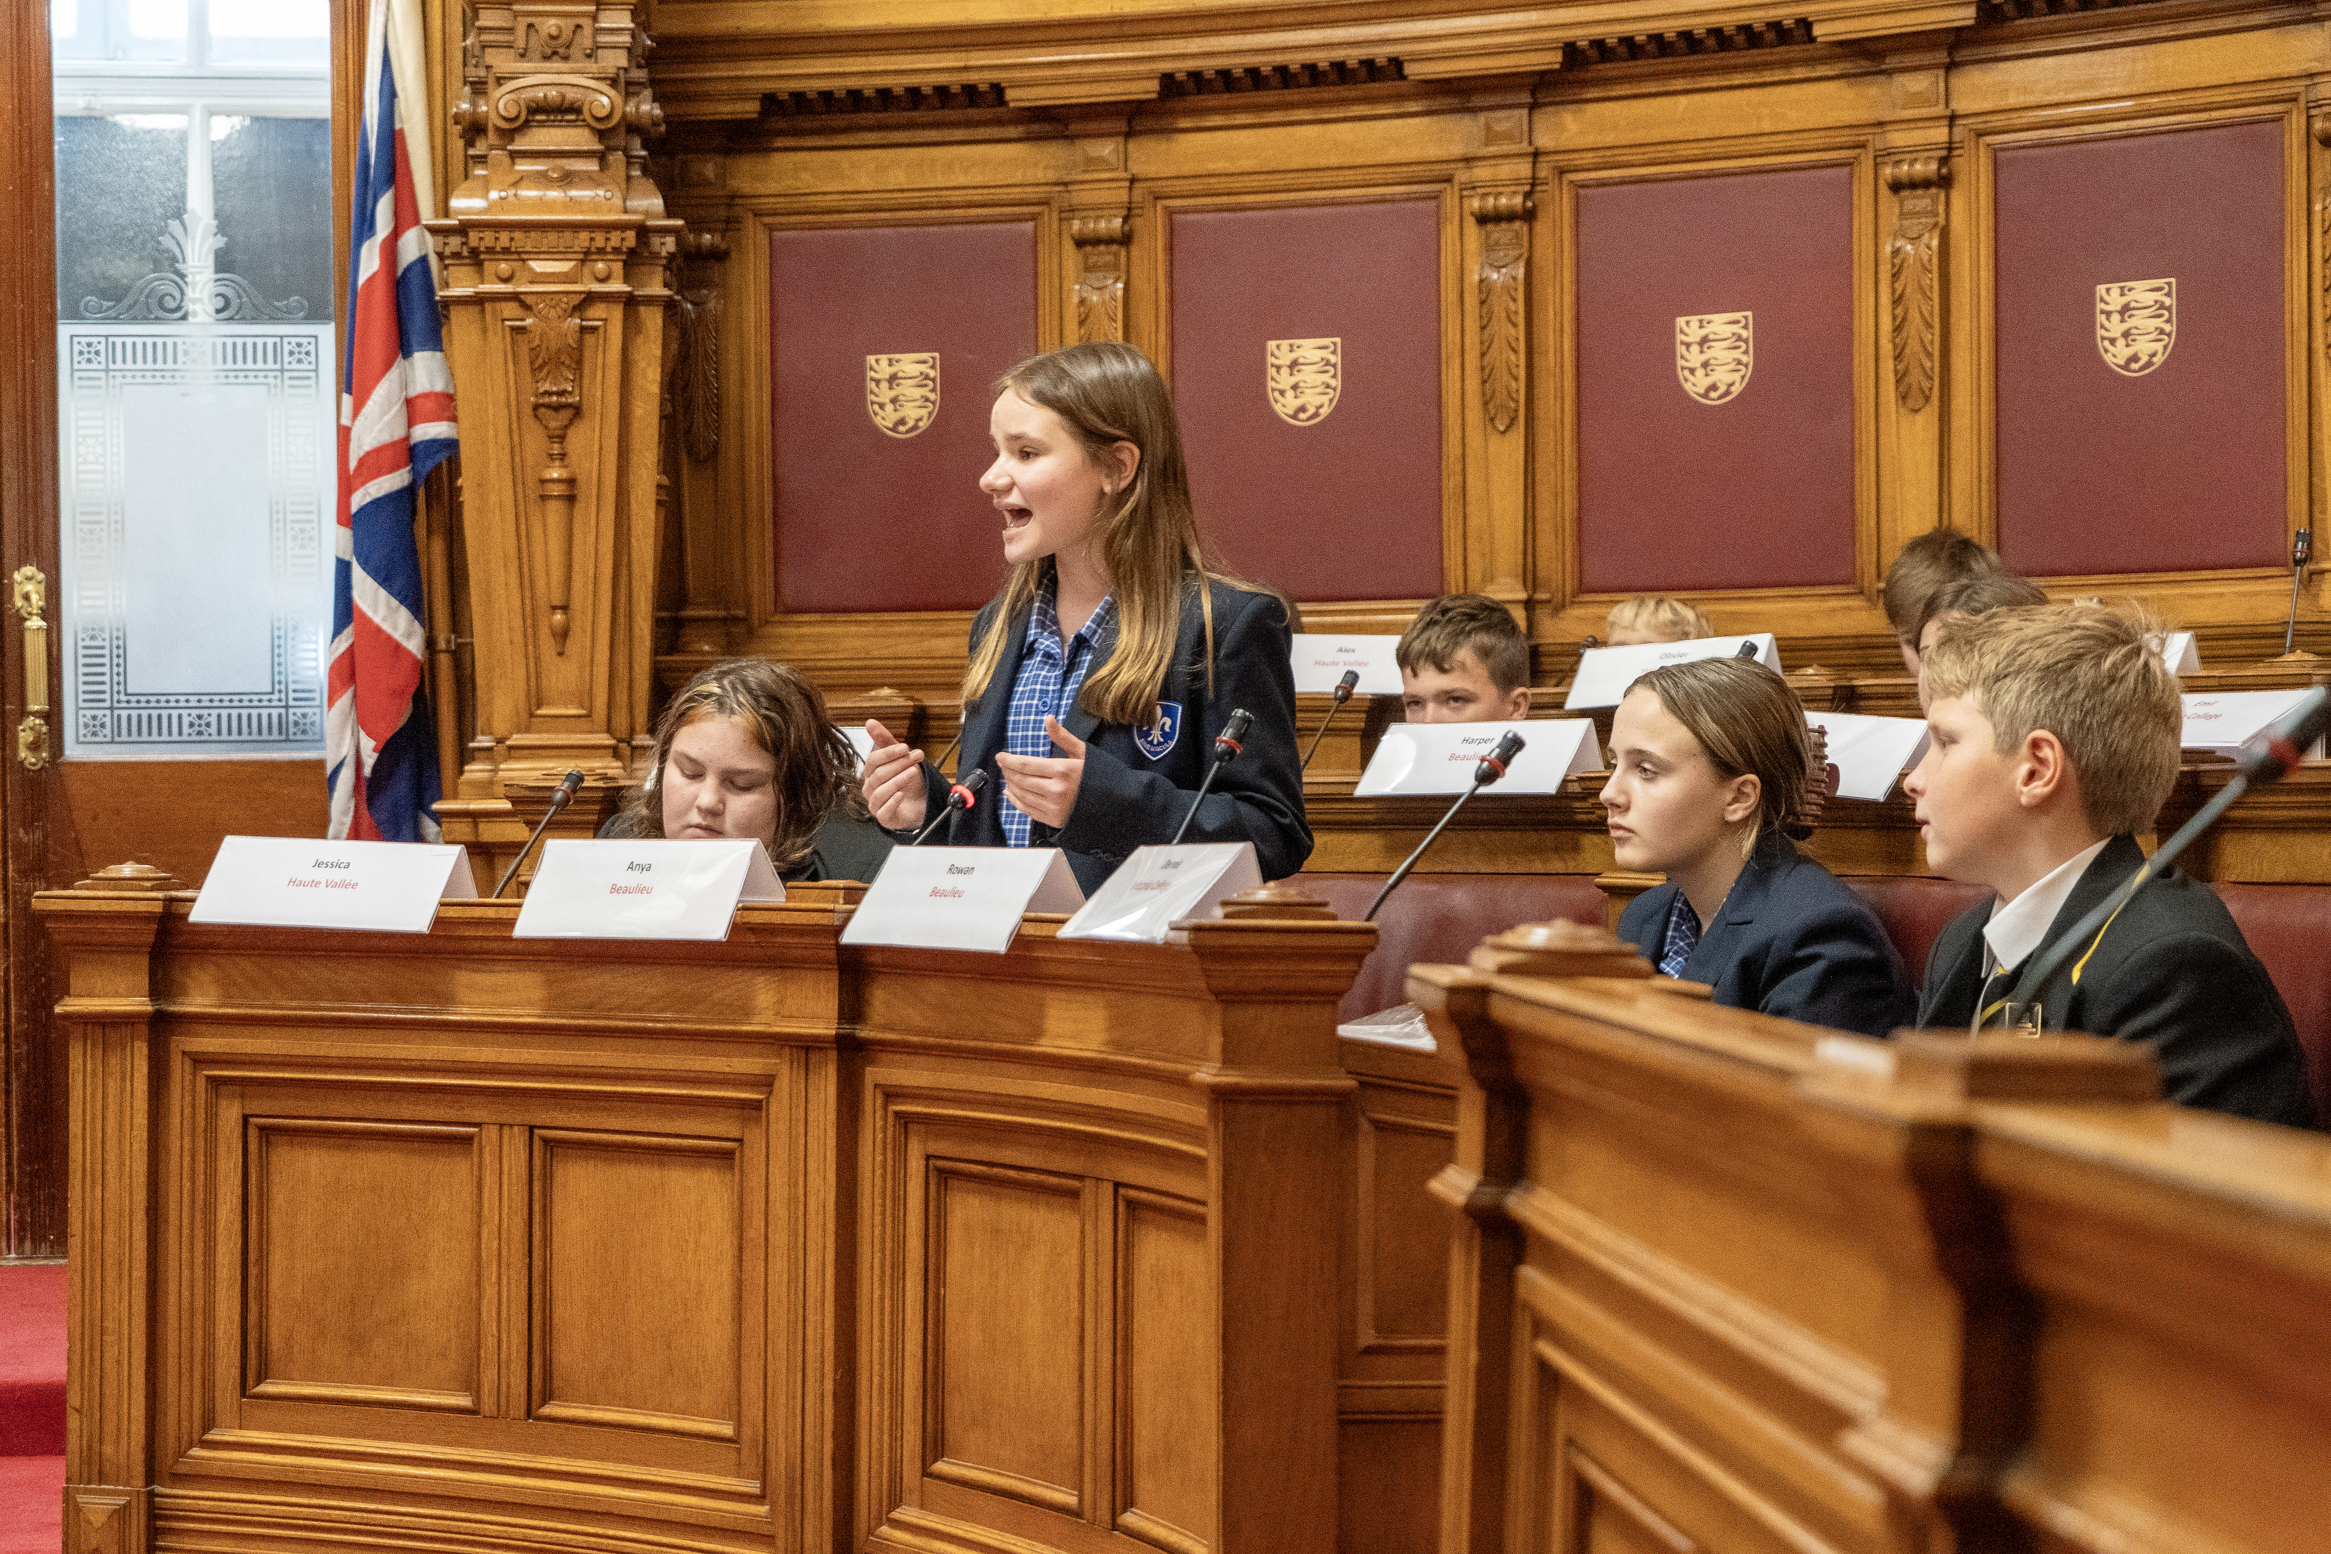
COMMUNICATING
How do I take a speech from page to stage?
Pair/Group/Class Discussion
THINK ABOUT: Voice, Face and Body
Notes:
What physical skills should be used when delivering your speech?

Slide 39


COMMUNICATING
How do I take a speech from page to stage?
How is your VOICE used to convey meaning, mood and message?
Volume
Pace
Pause
Fluency
Pronunciation and Enunciation
Intonation
Notes:
Volume
Projecting your voice to the back of the room but not shouting.
Pace
Varying your speed for message and mood but never rushing.
Pause
Leaving a short, purposeful gap to let a point sink in.
Fluency
Speaking continuously, without hesitance or ‘ums’ and ‘ers’.
Pronunciation and Enunciation
Saying words correctly and clearly to ensure understanding.
Intonation
Varying your pitch and tone to create expression and meaning.

Slide 40

COMMUNICATING
How do I take a speech from page to stage?
How is your FACE used to convey meaning, mood and message?
Expression
Changing your facial expression to convey
mood and meaning.
Eye Contact
Raising your eyes to look at your audience
Notes:
Expression
Changing your facial expression to convey
mood and meaning.
E.g. By raising one or both eyebrows, furrowing
your brow, widening or narrowing your eyes,
wrinkling your nose, smiling or frowning.
Eye Contact
Raising your eyes to look at your audience and
moving them around the audience rather than
looking down or staring at one fixed point.

Slide 41

COMMUNICATING
How do I take a speech from page to stage?
How is your BODY used to convey meaning, mood and message?
Posture
Stance
Gesture
Notes:
Posture
Standing up straight, shoulders back, head up.
Stance
Standing in a strong stance with feet firmly
planted. For this speech you would be at a podium
in the States Chamber, so not moving about.
Gesture
Using gestures where appropriate to add meaning or
emphasise a point e.g. shaking or nodding your head,
shrugging your shoulders, raising your hands or
pointing.

Slide 42
COMMUNICATING
Taking a speech from page to stage
Pair/Group/Class Discussion
Why are these physical skills so important when it comes to public speaking?

Slide 43
COMMUNICATING: From page to stage
Why Oracy should be compulsory in Schools
TASK 5: Watch the EXEMPLAR SPEECH again and identify any physicals skills used
(VOICE, FACE,BODY) on the worksheet. Use the key words at the bottom to help you.
Notes:
EXEMPLAR SPEECH: Mark My Words - YouTube

Slide 44
Week 3 – Communicating
(continued)
Objective:
Students evaluate, rehearse and improve their Public Speaking skills: practising their speech and in front of others.
Approx 1 lesson

Slide 45
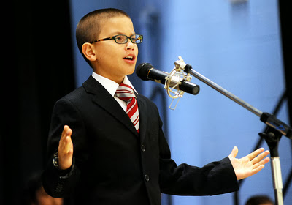
COMMUNICATING
How do I take a speech from page to stage?
Pair/Group/Class Discussion
Strengths and Weaknesses
What will you have to work on the most? Voice? Face or Body?
Notes:
Share with each other what you think your individual strengths and weaknesses are when it comes to public speaking.
What will you have to work on the most? Voice? Face or Body?

Slide 46

COMMUNICATING: From Page to Stage
OVER TO YOU: Time to practise presenting
Practise presenting your speech with minimal prompts (try cue cards/a story map).
Try this on your own first and then in front of a trusted partner.
REMEMBER TO THINK ABOUT THOSE PHYSICAL SKILLS:
VOICE: Volume, Pace, Pause, Fluency, Pronunciation, Enunciation, Intonation
FACE: Expression and Eye-contact
BODY: Posture, Stance, Gesture

Slide 47



Communication Checklist?
Am I speaking well?
TASK 6: Evaluate your presentation skills by filling in the Communication Checklist
VOICE:
Volume: Am I projecting my voice so that it can be heard clearly, and varying the volume?
Pace: Is my pace suitable for the audience and varied to emphasise mood and message?
Pause: Am I using pauses between paragraphs and to emphasise a point?
Fluency: Am I speaking precisely, concisely, clearly and correctly?
Intonation: Am I varying the pitch and tone of my voice to create meaning and emotion
FACE:
Expression: Am I varying my facial expression to create meaning, mood and emotion?
Eye Contact: Am I making and maintaining eye-contact with my audience?
BODY:
Posture: Am I standing up straight, shoulders back, head up?
Stance: Am I standing in a strong, still stance with feet firmly planted?
Gesture: Am I using gestures where appropriate to create a mood or emphasise a point?

Slide 48
Week 3 – Critiquing
Objective:
Students revisit and develop their critical thinking skills with a focus on summarising, evaluating and questioning the propositions of others and responding effectively to questions on their own proposition.
Approx 1-2 lessons

Slide 49

CRITIQUING PUBLIC SPEAKING
Pair/Group/Class Discussion
Consider your role as a critically thinking AUDIENCE when you hear other people’s speeches.
How can you LISTEN to and QUESTION other speeches effectively?

Slide 50

CRITIQUING PUBLIC SPEAKING
How do I listen and question effectively?
SUMMARISE THE SPEECH: Make a note of the main ideas and arguments of the speech
as you listen in order to maintain concentration and jog your memory on the key points later.
QUESTION THE SPEAKER IN ORDER TO:
CLARIFY: Check your understanding and receive a clearer explanation of an issue/argument
BUILD: Develop, add to or expand on an idea
PROBE: Dig deeper and ask for more evidence or justification of an idea
CHALLENGE: Disagree offering a reason why, or present an alternative argument or idea

Slide 51
CRITIQUING PUBLIC SPEAKING
Can I question, clarify and challenge?
TASK 7: Watch the EXEMPLAR SPEECH again and fill out Worksheet 7 which prompts
you to summarise the main ideas of the speech and write some questions in response that
seek to CLARIFY, BUILD, PROBE and CHALLENGE the argument.
Notes:
EXEMPLAR SPEECH: Mark My Words - YouTube

Slide 52
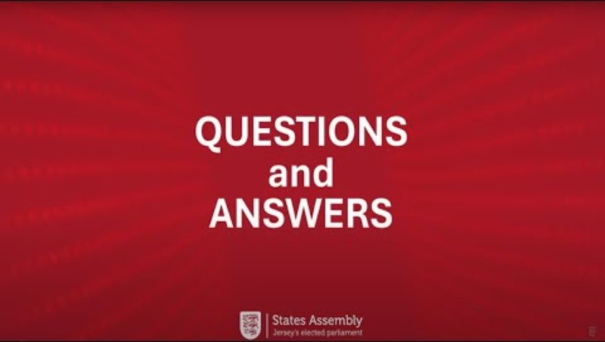
CRITIQUING PUBLIC SPEAKING
How to Question and Respond
TASK 8: Watch the VIDEO showing questions and answers to the Exemplar Speech.
Fill out Worksheet 8 which prompts you to note down the questions asked, identify the type
of question asked (CLARIFY, BUILD, PROBE or CHALLENGE)and evaluate the answer.
Notes:
Q+A: Mark My Words

Slide 53

CRITIQUING CHECKLIST
Practising Questions and Answers
TASK 9: In pairs or groups, deliver your speech to each other.
THE LISTENER(S) will fill out Worksheet 9 - a new blank Worksheet for each speech.
1) Summarising the main points of the speech.
2) Brainstorming as many high-quality questions as possible in response to the speech.
3) Selecting the TWO BEST questions and posing them to the Speaker
4) Evaluating the Speaker’s answers, judging whether they are prompt (with minimal
hesitation) direct (relevant to the question) clear (easy to understand) and full (a
comprehensive answer to what was asked).
THE SPEAKER will have no advance notice of the questions and will answer them on the
spot as fully and clearly as possible.

Slide 54
‘Mark My Words’ – Year 8 Oracy Competition
Who will be your School Champion?
INTERNAL COMPETITIONS: by Tuesday 22nd September 2026
Class competition – Students deliver speeches and answer questions to find a class winner Year group competition – Class winners compete to find an overall school winner
EXTERNAL COMPETITION – Friday 25th September 2026
Each school sends their Year 8 finalist to the main competition at the States Chamber. A maximum of 5 other Year 8 students can accompany them to form a team that will craft and pose questions to the finalists from other schools.

Slide 55
‘Mark My Words’ – Year 8 Oracy Competition
Have I successfully met the Learning Objectives?
Student Success Criteria:
All Year 8 students write a persuasive speech, of up to 3 minutes, arguing for a particular change or improvement in Jersey. All Year 8 students present their speech to their peers and respond to questions. All Year 8 students frame questions in response to the speeches they hear to clarify, probe, build or challenge. All Year 8 students revisit and develop the skills of transactional writing, public speaking and critical thinking. Some students deliver their speech and participate in questioning at competition level within the States Chamber.

Slide 56
Thank you for participating
in the ‘Mark my Words’
Year 8 Oracy Competition
statesassembly.je

